Slide 1

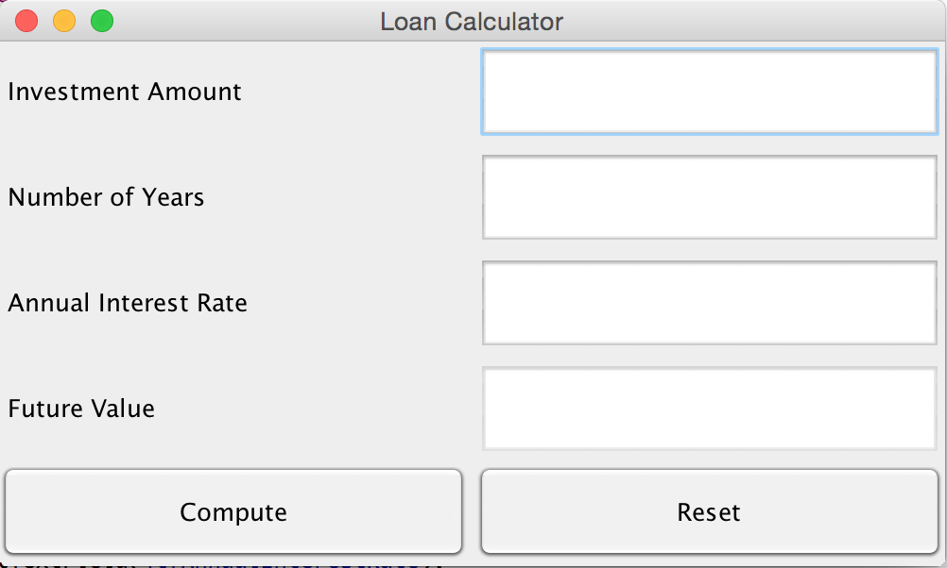
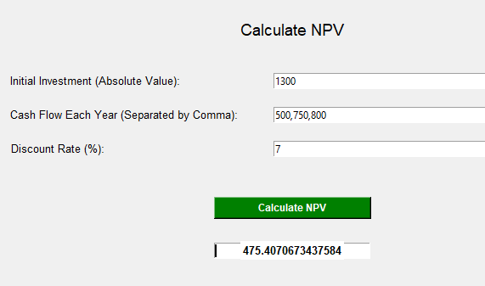
Financial Calculator
Created by Rachel Straiton
Make the average finance major’s life easier with a push of a button.
Repository: Finance Calculator

